Slide 1
CS 205
Artificial Intelligence

Slide 2
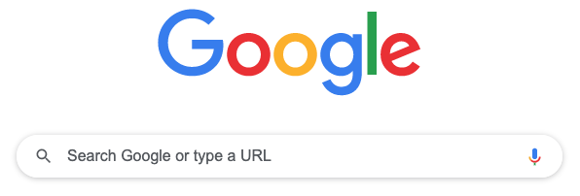
Search
Blind Search
Uniform Cost Search
Heuristic Search — A*
Adversarial Search — Minimax
Let's take a look at Prof Eamonn's slides for a minute.

Slide 3
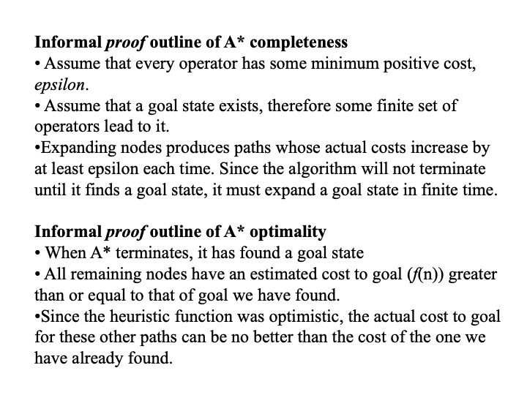
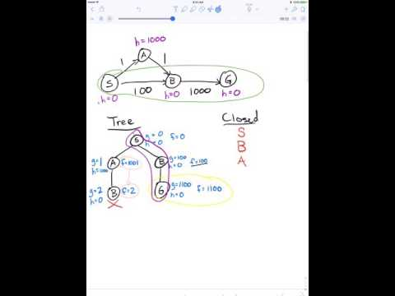
A* proof idea...

Slide 4
Adversarial Search
.... what if we have an enemy, who is at least as good as we are?
Deterministic vs Stochastic
Chess, checkers, tic-tac-toe, battleships
Monopoly, scrabble, poker
Two- vs Multi-player
Competitive vs Cooperative
We will focus on deterministic, two-player, competitive games.

Slide 5
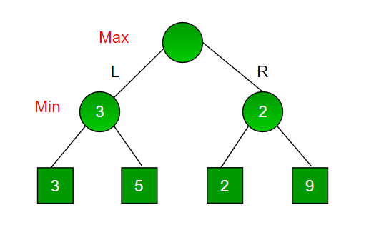
Minimax Algorithm
Max is the first player
Min is the adversary.
initial state
operators
end state (or game over or terminal test)
utility function
Utility function: like a heuristic, tells us how "good" a move is, usually on a scale of -1 to 1. Positive favors Max, Negative favors Min.

Slide 6
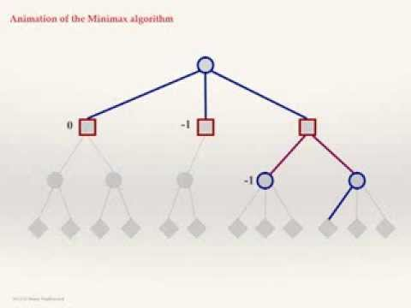

Minimax Algorithm
The gist...
Max anticipates Min, and tries to suffer their least damage.
Read that again, carefully!
Be careful — Max is not necessarily after the biggest possible payoff. Why? Because Min is also trying to win! And Min is just as smart. So Max wants the best likely outcome, given that Min is trying for the worst. So, instead of the best, Max wants the least worst.

Slide 7
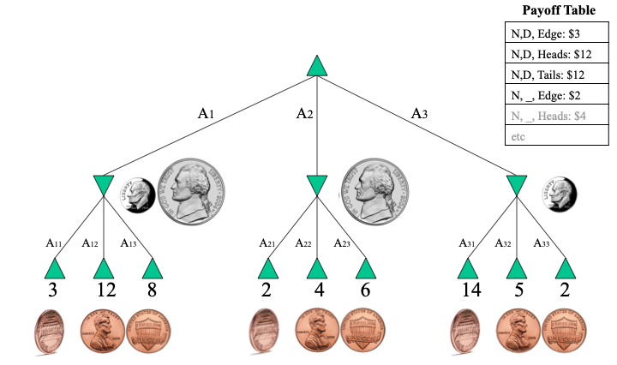
Utility Function
Regardless of the game (i.e., interpretation), the utility function is simply a payoff table.
It tells us what each outcome awards.

Slide 8
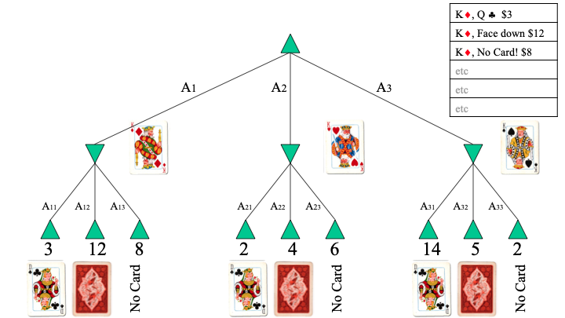
Utility Function
Regardless of the game (i.e., interpretation), the utility function is simply a payoff table.
It tells us what each outcome awards.

Slide 9
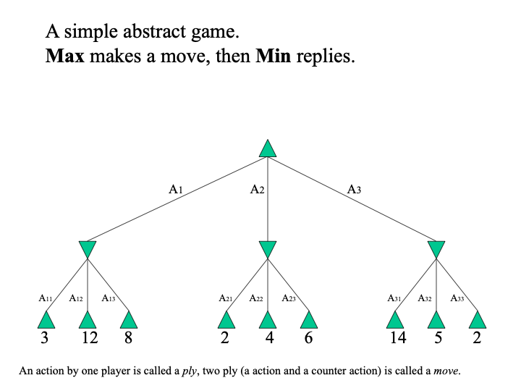
Utility Function
Regardless of the game (i.e., interpretation), the utility function is simply a payoff table.
It tells us what each outcome awards.
Max desires 12, 6, and 14...
Min desires 3, 2, 2 ...
Best Max can do is 3.
Max
Min

Slide 10
Minimax Algorithm
Generate the game tree down to the terminal nodes.
Apply the utility function to the terminal nodes.
For a S set of sibling nodes, pass up to the parent…
the lowest value in S if the siblings are
the largest value in S if the siblings are
Recursively do the above, until the backed-up values reach the initial state.
The value of the initial state is the minimum score for Max.
Remember: Max is the one deciding the next move. Min is not doing anything yet. Max is simply anticipating Min's counter-moves (i.e., assuming Min is trying to best them).

Slide 11
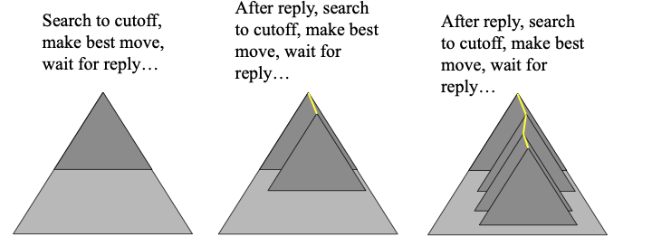
Minimax
Optimal!
Complexity: O(b^{m}) where b is the branching factor and m is the depth of end states.
This is a major problem because O(b^{m}) sucks. Possible solutions?
Depth-limited Minimax. How might that work?

Slide 12
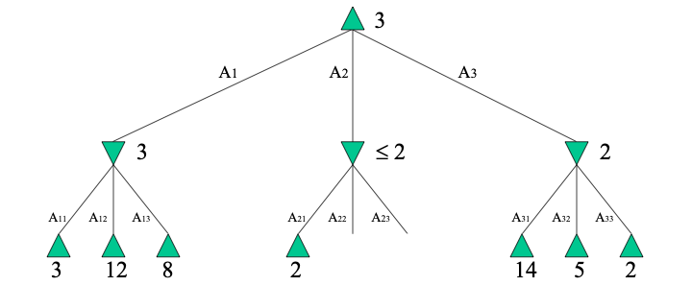
Alpha-Beta Pruning
If you have an idea that is surely bad, don't take the time to see how truly awful it is. –Pat Winston
I don't care what those are. They are already worse than 3.
So I won't bother checking.

Slide 13
Alpha-Beta Pruning
Best case: we can search twice as deep!
Best insight: operators should be ordered carefully such that Max nodes with largest values (and Min nodes with smallest) are generated first. This induces the best case scenario.
Most important takeaway: even this is not a steal. All our time should be spent on better utility functions. Period. Recall A* — all our time should be spent on better heuristic functions.

Slide 14
Take Home Message
We cannot beat Minimax (but Alpha-Beta is helpful). All our time should be spend on better utility functions. Period.
Just like...
We cannot beat A*. All our time should be spent on better heuristic functions. Period.

Slide 15
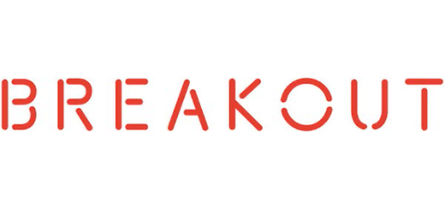
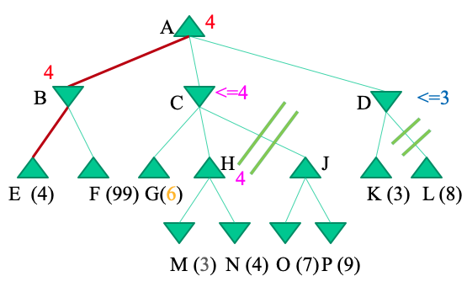
Discuss
Explain why H must be explored.
Explain why N must be explored.
Explain why J & L do not need to be explored.

Slide 16
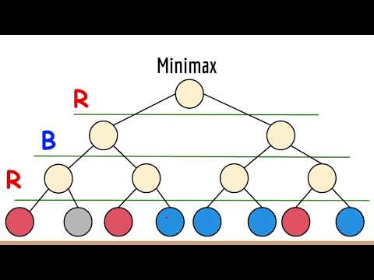
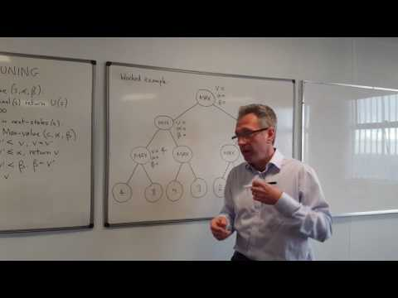
Additional Resources

Slide 17
Search
Blind Search
Uniform Cost Search
Heuristic Search — A*
Adversarial Search — Minimax
Let's take a look at Prof Eamonn's slides for a minute.

